Slide 1

Example Result

Slide 2

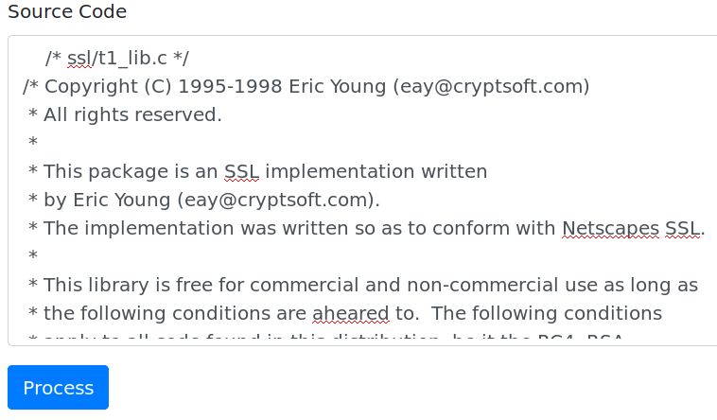
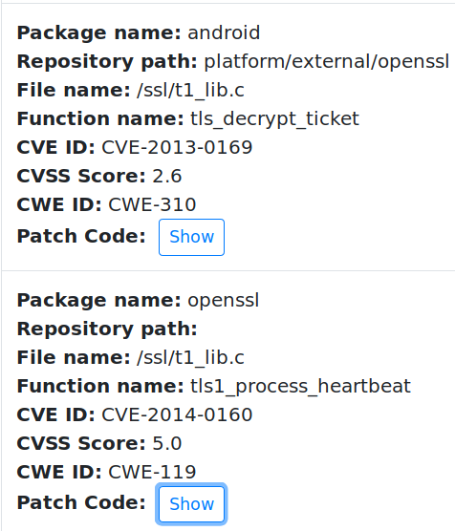
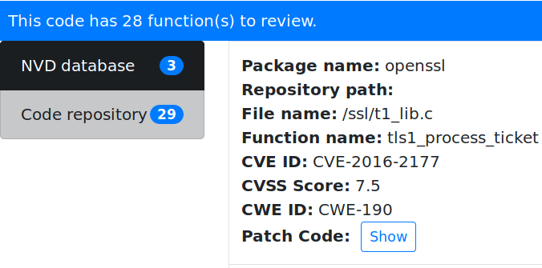

Example Result: Code Matched 3 Vulnerabilities

Slide 3
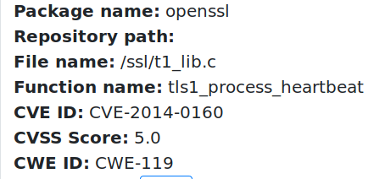
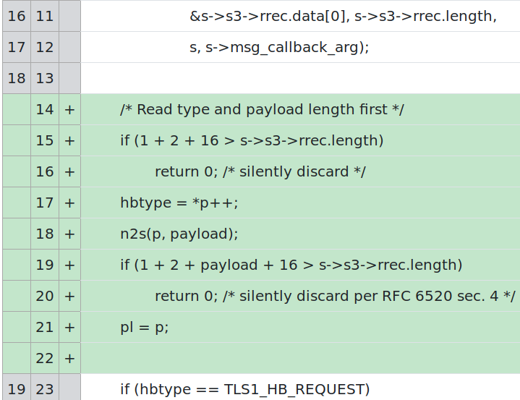
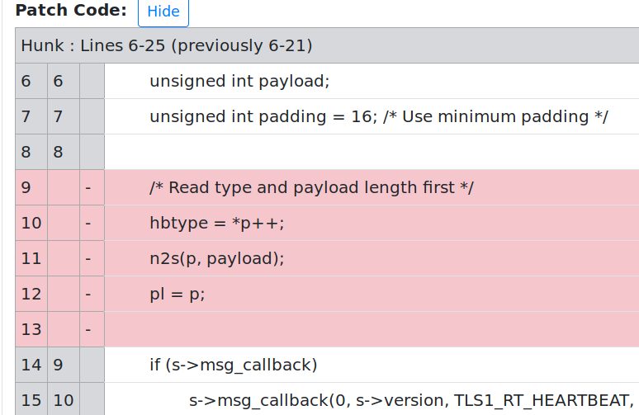
Example Result: A Matched Vulnerability And Its Fix

Slide 4
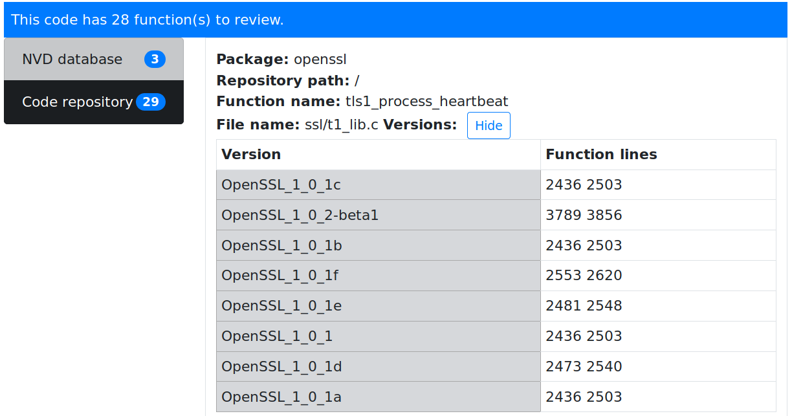
Example Result: Versions that are vulnerable

Slide 5


